Slide 1
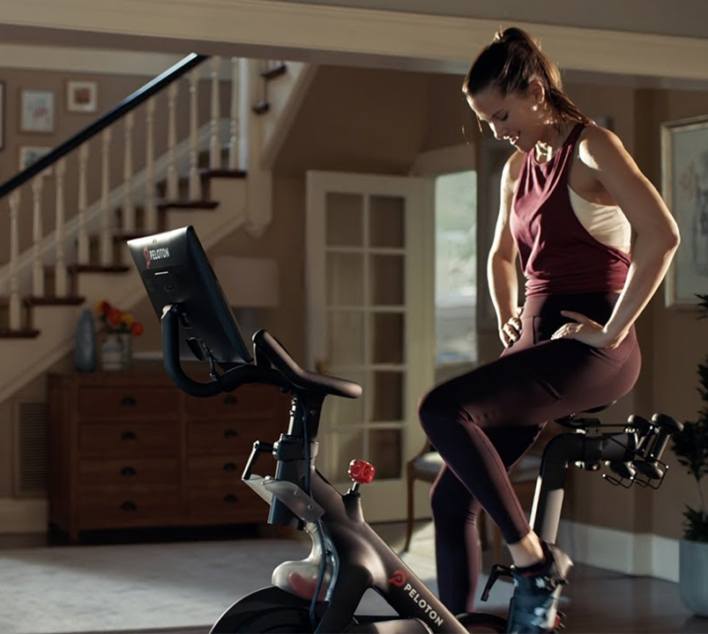

Final Project: Peloton
MODULE 2 ASSIGNMENT

Slide 2
Discussion Questions
How can you apply the ideas discussed today to the Peloton case?

Slide 3
Project Structure
The project case is an opportunity to devise a strategic recommendation through application of the SGT strategy frameworks learned in the trainings
MODULE 1
MODULE 2
MODULE 3
OFFICE HOURS
INTRO TO PLAYING TO WIN
CHOICE STRUCTURING RESEARCH & ANALYSIS
HYPOTHESIS
TESTING
OPTIONAL WORKING SESSION
Review case study files, understand Peloton’s current strategy, and identify issues
Ideate, brainstorm strategic options, and identify conditions and barriers
Conduct critical testing for specified strategic options.
Prepare for the final readout of the team’s recommended strategy
Today’s Focus
MODULE 4
FINAL PRESENTATION

Slide 4
Module 2 Assignment
The following tasks are due on Wednesday, September 21st at 5pm EST. Each group should submit a PPT containing each deliverable in this deck to the SGT Bootcamp Teams link by this time
1
DISCUSS PELOTON’S AMBITIONS AND DRAFT STRATEGIC OPTIONS
What is Peloton’s level of ambition in health and wellness sector? Use the Ambition Matrix to help guide your group discussion.
Create a list of 3-4 compelling and differentiated strategic options that can help Peloton meet its aspirations. Leverage the ideation methods discussed in the Module 2 training to draft these options.
Plot these options on the ambition matrix and check that they match the first discussion in this section.
DELIVERABLES: LIST OF STRATEGIC OPTIONS & AMBITION MATRIX
2
COMPLETE CHOICE CASCADES FOR EACH STRATEGIC OPTION
For each option, create a choice cascade to express how it would be a robust solution to help Peloton achieve their goals
DELIVERABLE: INDIVIDUAL CHOICE CASCADES
3
IDENTIFY CRITICAL CONDITIONS & BARRIERS
Identify critical conditions for each of your options. What would need to be true for your options to be viable solutions?
Identify which of these conditions are barriers that would need to be tested in order to have a base level of confidence to pursue the option
DELIVERABLE: CRITICAL CONDITIONS & BARRIERS

